Slide 1
ERROR CORRECTION

Slide 2
With which of the following do you have the most sympathy?
View 1: errors made by students are evidence that something has gone wrong in the teaching-learning process.
View 2: making errors is a natural part of learning a language and should be viewed positively as an opportunity to help the learner.
Notes:
There is no right answer to this question but you should know that what you believe about error is likely to affect how you handle it.
View 1: is often held by those who believe that learning a language is mostly about forming good habits and, through lots of practice and repetition, we can get to the point where we are producing correct language automatically, almost without thinking.
View 2: is often held by those who see language learning as a process of thought: learning by testing hypotheses, adjusting our theories, comparing what we say with what we hear and noticing gaps in knowledge for ourselves. For these people, errors are seen as developmental.
These are very different ways of seeing the process.

Slide 3
1. What’s an error?
2. What’s a slip?
3. Why do some teachers think it is important for learners to make mistakes?
4. What can teachers learn from learners’ mistakes?
5. What is the teachers’ role in relation to learners’ mistakes?
Notes:
Main room wrap up and reflection- here is what I noted from my imaginary ss doing that task.
Rationale for EC and FB:
What type of errors did I note? Errors v slips, relevance to comm task, room for improvement and working on lang

Slide 4
1.An error is a mistake a learner makes when trying to say something that is above their level of language. They would not be able to self correct an error.
2. A slip is a mistake a learner makes that they are able to correct themselves.
3. Errors are considered to be important because they are an important and necessary part of language learning, learners need to experiment with language in order to work out how language works.
4. Teachers can learn what learners know, what they need to be taught and they can find out what aspects of language they have processed. This enables teachers to adapt their teaching programme.
5. The teachers’ role in relation to students’ mistakes is deciding if, when and how to correct.

Slide 5
Harmer, J. (1997). How to Teach English

Slide 6
Discussion

Slide 7
How do we handle errors?
Step 1: RECOGNITION

Slide 8
Find the errors in sentences 1-6 and match them with the classifications (a-f). Then compare your answers with a partner.
Errors | Classification
1 'She likes her job. She works for the same company for years.' | a problem with word stress
2 (In a restaurant) 'Bring me the menu!’ | b problem with intonation
3 'My brother fell off his bike but he wasn't badly damaged.' | c problem with word order
4 'It's a lovely day, isn't it?' | d problem with choice of word(s) - vocabulary
5 'This sofa is very comFORTable.' | e problem with appropriacy and style
6 'Where is standing the teacher?' | f problem with the choice of verb form

Slide 9
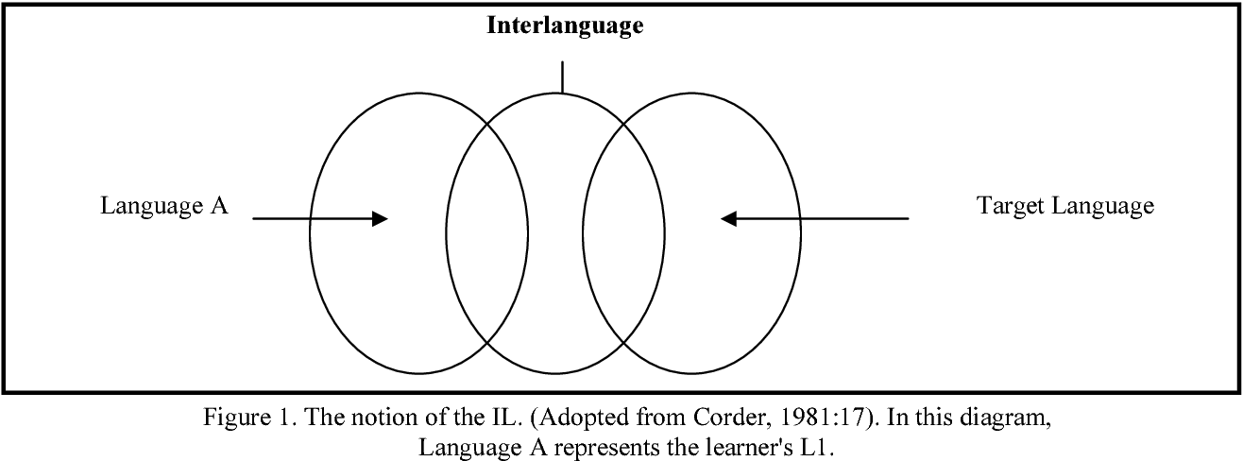

Slide 10
It is, of course, crucial to know where a learner's interlanguage currently is. There are three reasons (at least) for this.

Slide 11
Reason 1: it tells us what the learner is likely to know already and that helps us plan what to teach.
Reason 2: it helps us to decide what to correct in class. There's little point in trying to correct a very elementary student who is trying to produce a complex third conditional form with a modal auxiliary verb because it will take too long and probably confuse the learners.
Reason 3: it helps us to recognise whether an error should be corrected by you or whether the error can be self-corrected by the learner.

Slide 13
Why do students make mistakes?
The learners own version of the second language which they speak as they learn. They create their own grammatical system as they are learning, which is neither their first language nor the target language but something in between the two. This version of their language changes as they progress and learn more.
interlanguage

Slide 14
Why do students make mistakes?
1. When the learner’s mother tongue affects their performance in the target language. A learner may make a mistake because they use the same grammatical pattern in the target language as they use in their mother tongue. The L1 grammatical pattern is not appropriate in L2.
L1 interference

Slide 15
Why do students make mistakes?
The process in which incorrect language become a habit and cannot easily be corrected.
fossilisation

Slide 16
Why do students make mistakes?
An error made by a second language learner which is natural part of the language learning process because they are unconsciously organising and working out language. These types of error are also made by children learning their first language and often disappear as their language ability improves.
developmental error

Slide 17
Why do students make mistakes?
When a student uses a grammatical rule he/she has learned, but uses it in situations when it is not needed or appropriate, e.g. a student says There were three girls (correct plural form used for most nouns) and two mans. (incorrect plural form – not appropriate for man).
overgeneralisation

Slide 18
How do we handle errors?
Step 2: how best to deal with it

Slide 19
Jim Scrivener (1994) writes:
1. Decide what kind of error has been made (grammatical? pronunciation? etc.).
2. Decide whether to deal with it (is it useful to correct it?).
3. Decide when to deal with it (now? end of the activity? later?).
4. Decide who will correct (teacher? student self-correction? other students?).
5. Decide on an appropriate technique to indicate that an error has occurred or to enable the correction.
To make the decisions above, we must hone our skills. The bigger our knowledge base, the easier to make these decisions, the better we can deal with them. Some suggested error correction techniques are explained below.

Slide 20
How again ?

Slide 21
Work in pairs. Compare the ways that different teachers responded to the same error. Explain their strategies.
S: We go to the cinema yesterday.
a. T1: Yesterday - so, grammar?
b. T2: Yesterday, you ....
c. T3: Not quite, look: We go to the cinema yesterday. [Holds up hand and indicates second finger from left from the learners' point of view.]
d. T4: Sorry, do you mean you go every day? •
e. T5: You went to the cinema - that's nice. Who did you go with?
f. T6: makes no comment; the activity continues until, at the end, the teacher says, 'I heard someone say, "We go to the cinema yesterday." Can anyone correct that?'
Correction strategy | Advantages | Disadvantages
a Teacher prompts using terminology, e.g. grammar, tense, pronunciation, etc. (Metalinguistic clues) | Easy to use. Indicates the type of error that the learner should be looking for. | Learners need to be familiar with the terminology used.
b Teacher repeats the utterance to the point of the error. e.g. Yesterday you ... | self-correction Direct / | embarrassing
c Finger correction (Teacher uses fingers to indicate the position of the error.) | visual learners Busy with actions | no one knows your class more than you .
d Teacher asks a question, e.g. Do you mean you go everyday? |  | Teacher-centred
e Reformulation, e.g. You went to the cinema | natural / positive | teacher-centred
f Delayed correction | polite / no embarrassment / saves time | learners may forget /
Notes:
Explicit correction with metalinguistic information more effective (Ellis et al, 2006)

Slide 22
LEXICAL UPGRADING:
I stay in bed longer than usual this morning.

Slide 23
I had a lie–in.

Slide 24
LEXICAL UPGRADING:
I wasn’t able to relax and worried since the early morning.

Slide 25
stressed

Slide 26
Tips from the DIP TESOL diploma
Plan with feedback in mind. Anticipate what errors they will make and think about what you can do to help.
Build feedback slots into your plan - leave time and space for it.
Monitor purposefully. Know what you are monitoring for, how you will gather data, and what you will do with it.
Don’t leave correction till the end of the lesson, or even until the end of the activity. Feedback on language that ss can use again in that lesson.
Plan your ‘board’.
Remember to contextualise language you board.

